Slide 1
Infrastructure Management
Group Members
Mythily R – 2016HW86057
Priyadharshini B -- 2016HW86671
Thirumeni Radha – 2016HW86392
Pavithra K ---2016HW86588
Nijaguna --- 2016HW86163
Pradeep --- 2016HW86131

Slide 2
Assignment 1:
SLA requirements for testing team and Monitoring
Speak to any of the testing team (software testing team)
List down all the IT applications
Tools they need to access
Get their uptime requirements
Speak to IT Manager
Get their SLA
Understand Monitoring and Reporting

Slide 3
various types of Software Testing
Functional Testing
Non-Functional Testing
Automation Testing
Agile Testing

Slide 4
Different Types Of Software Testing
Non-functional Testing types include:
Functional Testing types include:
Performance Testing
Load Testing
Stress Testing
Volume Testing
Security Testing
Compatibility Testing
Install Testing
Recovery Testing
Reliability Testing
Usability Testing
Compliance Testing
Localization Testing
Unit Testing
Integration Testing
System Testing
Sanity Testing
Smoke Testing
Interface Testing
Regression Testing
Beta/Acceptance Testing

Slide 5

Automation Testing Tools for Software Testing
Selenium
Selenium is a testing framework to perform web application testing across various browsers and platforms like Windows, Mac, and Linux.
Selenium helps the testers to write tests in various programming languages like Java, PHP, C#, Python, Groovy, Ruby, and Perl.
It offers record and playback features to write tests without learning Selenium IDE.
Selenium is undoubtedly the base for most of the other software testing tools in general.

Slide 6

TestingWhiz tool:
TestingWhiz tool’s Enterprise edition offers a complete package of various automated testing solutions like
web testing,
software testing,
database testing,
API testing,
mobile app testing,
regression test suite maintenance, optimization, and automation, and cross-browser testing.

Slide 7


Ranorex
Ranorex Studio offers various testing automation tools that cover testing all desktop, web, and mobile applications.
Ranorex offers the following features:
GUI recognition
Reusable test codes
Bug detection
Integration with various tools
Record and playback
Sahi
Sahi is a testing automation tool to
automate web applications testing.
The open-source Sahi is written in Java and
JavaScript programming languages.

Slide 8
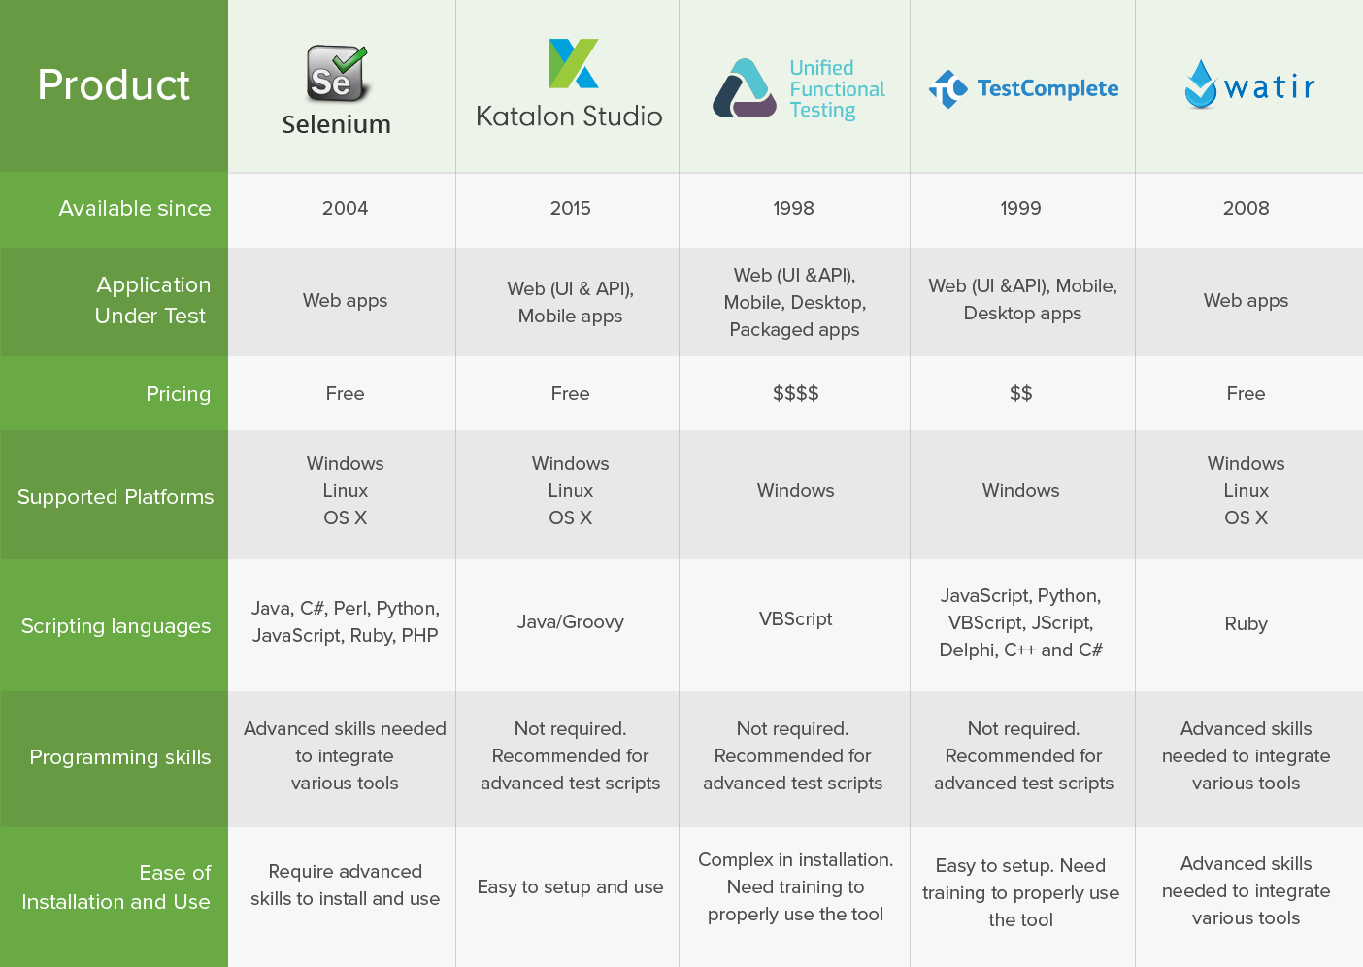

Slide 9
Information technology management (IT Manager)
Managing IT staff by recruiting and training employees, communicating job expectations, and monitoring performance.
Overseeing the annual IT budget and ensuring cost effectiveness.
Monitoring daily operations, including server hardware, software, and operating systems.
Coordinating technology installations, upgrades, and maintenance.
Selecting and purchasing new and replacement hardware and software, when necessary.
Testing, troubleshooting, and modifying information systems so that they operate effectively.
Generating performance reports for operating systems.
Assuring all IT activities are performed within the parameters of applicable laws, codes, and regulations.
Evaluating technology risks in order to develop a network disaster recovery plan and backup procedures.
Remaining up to date with advances in technology and industry best practices.

Slide 10
Test Monitoring
Test progress monitoring The purpose of test monitoring is to give feedback and visibility about test activities. Information to be monitored may be collected manually or automatically and may be used to measure exit criteria, such as coverage. Metrics may also be used to assess progress against the planned schedule and budget.
Common test metrics include:
Percentage of work done in test case preparation (or percentage of planned test cases prepared).
Percentage of work done in test environment preparation.
Test case execution (e.g. number of test cases run/not run, and test cases passed/failed).
Defect information (e.g. defect density, defects found and fixed, failure rate, and retest results).
Test coverage of requirements, risks or code.
Subjective confidence of testers in the product.
Dates of test milestones.
Testing costs, including the cost compared to the benefit of finding the next defect or to run the next test.

Slide 11
Reporting
A summary of test activities and final test results
An assessment of how well the Testing is performed
Based on the test report, the stakeholders can
Evaluate the quality of the tested product
Make a decision on the software release. For example, if the test report informs that there’re many defects remaining in the product, the stakeholder can delay the release until all the defects are fixed.

Slide 12
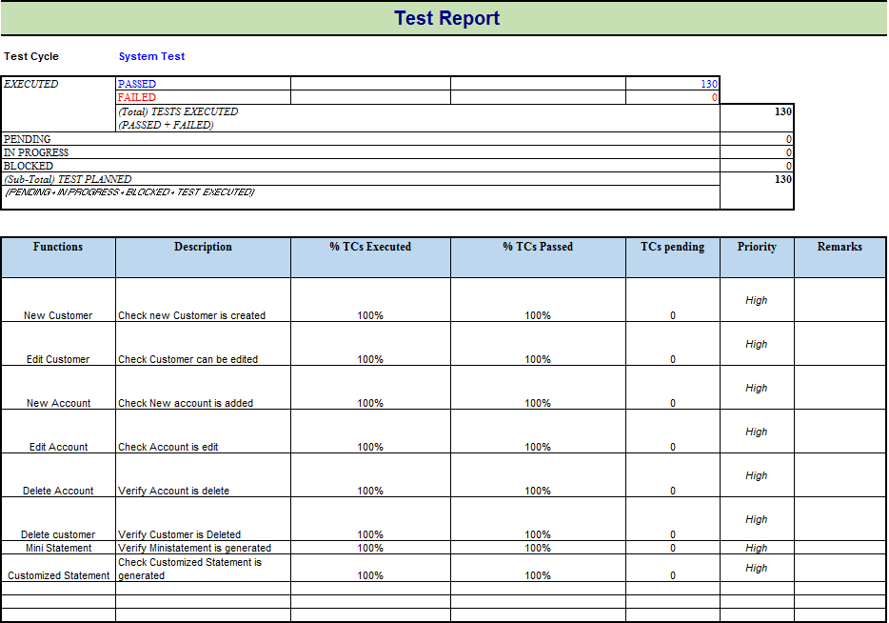

Slide 13
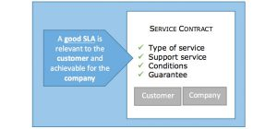
SLA
A service level agreement is a formal or informal contract between internal or external and the end user of the service. It specifies what the client will receive and clarifies what is expected of the service provider.

Slide 14
Types of SLAs
Service-based SLA
Applies a standard SLA to all customers that contract the same service. It is useful when our company offers several services with different resolution and response times.
Customer-based SLA
Applies to all contracted services by a customer, a group of customers or the same business area.
Multilevel SLA
Combines service and customer SLA, and applies at a corporate level for all users in an organization too. Multilevel SLAs avoid duplication and incompetence between several agreements, making it possible to integrate several conditions into the same system.

Slide 15
Components of a Service Level Agreement
Service description: What does the service provider do?
Reliability: When should the service be available?
Responsiveness: How quickly should services be delivered?
Reporting procedure: How and to whom should problems be reported? What reporting process is used in routine tasks (if any)?
Performance monitoring: How will performance be monitored, who will monitor it, and how will it be measured?
Penalties for failure to meet obligations: What penalties will be implemented if the service provider fails to perform as stipulated?
Constraints: Under what circumstances will the terms of the service level agreement be waived?

Slide 16


